Slide 1
RISE OF THE RESTAURANT ROBOTS
A TECHNICAL PERSPECTIVE
Technical Presentation

Slide 2
Goal of the project
To build a robot that would be used in a restaurant setting.
The robot would do the following:
Take orders from the customer through an graphical user interface.
Navigate to the chef’s location in the restaurant.
Take the order and deliver to the customers location.

Slide 3
Additional Features
The robot would use computer vision to obey traffic lights on its way.
The robot would stop at a red light and at a stop sign.

Slide 4
System Overview.
The following are components of the system.
Turtlebot Burger.
Graphical User Interface
Object Detection Model

Slide 5
TurtleBot Burger
Is a three layered robot consisting of the following:
OpenCR board
Raspberry pie
Lidar sensor

Slide 6
Object Detection.
This step involved data collection, model training, and model deployment.
Data collection involved data annotation which is basically cropping of images to ensure that only the object of interest is in the image. This is done through Roboflow software.
Model training was done on google colab.

Slide 7
Movement of the Robot.
MoveBase API was used.
Move base is an API that is enables autonomous navigation capabilities of the robot.
It has inbuilt algorithms that enable the robot determine the best path to the goal.

Slide 8
Graphical User Interface.
QT GUI creator was used to create the interface.

Slide 9
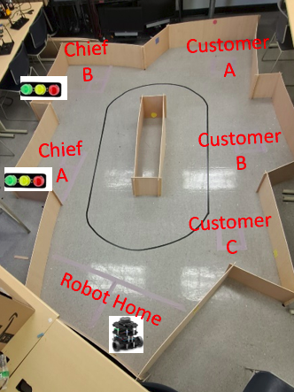
Implementation Steps.
The following were the key steps followed to achieve the goal.
Mapping.
First was to implement move_base API. To be More precise move base simple goal topic was used to publish destination goals depending on the input from the GUI.
Connect the IMU sensor to openCR board.
Build and deploy the object detection model.
Testing.

Slide 10
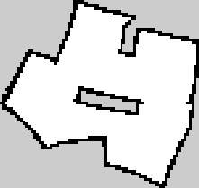
Implementation Steps cont.

Slide 11
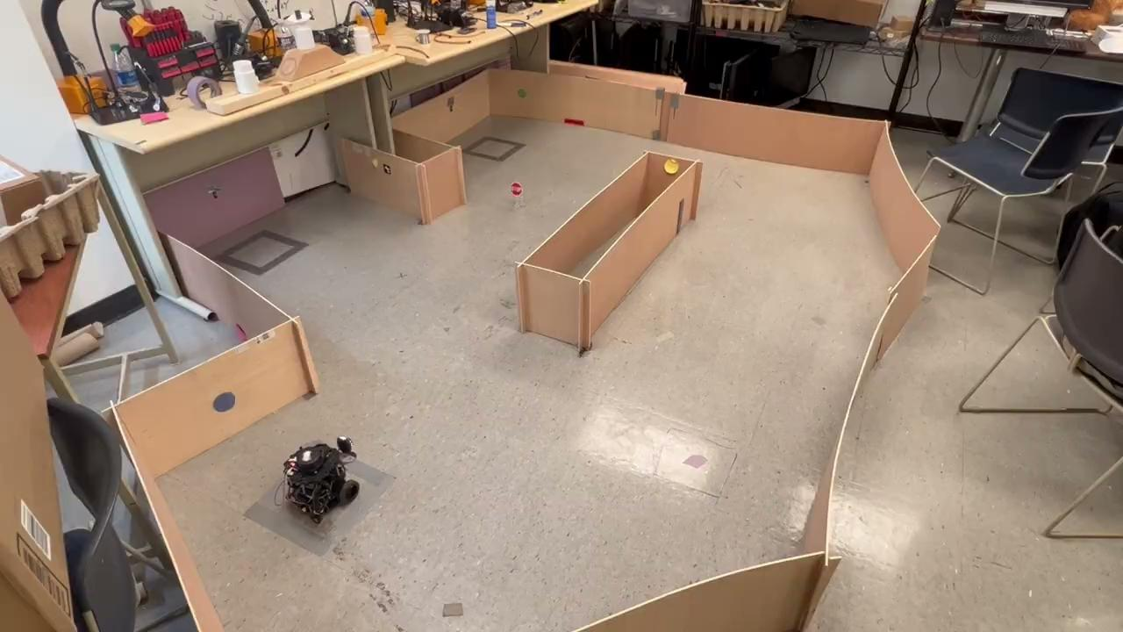
Demonstration Video.
.

Slide 12
.

